Slide 1

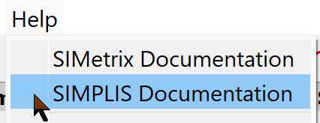

Welcome to
SIMPLIS Essentials Training
Before we get started, you need to:
  1. Locate the Questions window in GoTo. This is how you will ask questions of the presenter.
  2. Open SIMetrix/SIMPLIS Elements 9.10: (Refer to email from Matthew Fortin
  Subject: Please Read -- Import Information: SIMPLIS Essentials starts in 1 Day)
    Or, go to this link: www.simplis.com/simplis-essentials-support-page
3. Verify you have the latest version
    Click on Help > Check for Updates Update as needed
4. Open Advanced SIMPLIS Training docs
    Click on Help > SIMPLIS Documentation
      Then click on
    Or, go to https://simplis.com/documentation/link/simplis/17160

Slide 2
SIMPLIS Essentials Training
11:00 am – 3:30 pm EDT
September 24 & 25, 2024
SIMPLIS Technologies
Tom Wilson
Matt Fortin
Christophe Basso
Jens Ejury
Chris Swartz
Ronald Wong
Instructors
Round Table

Slide 3
SIMPLIS Essentials Training
Daily Schedule:
11:00 am EDT Welcome
11:05 am Begin class
~1:00 pm 20 min Lunch Break
~1:30 pm Begin second session
~ 2:45 pm Christophe Basso (Sampling of > 130 SIMPLIS Templates for Switching Power Supplies. Modeling and Measurement techniques)
3:30 pm Done for the day
We will start on time
We will finish on time

Slide 4
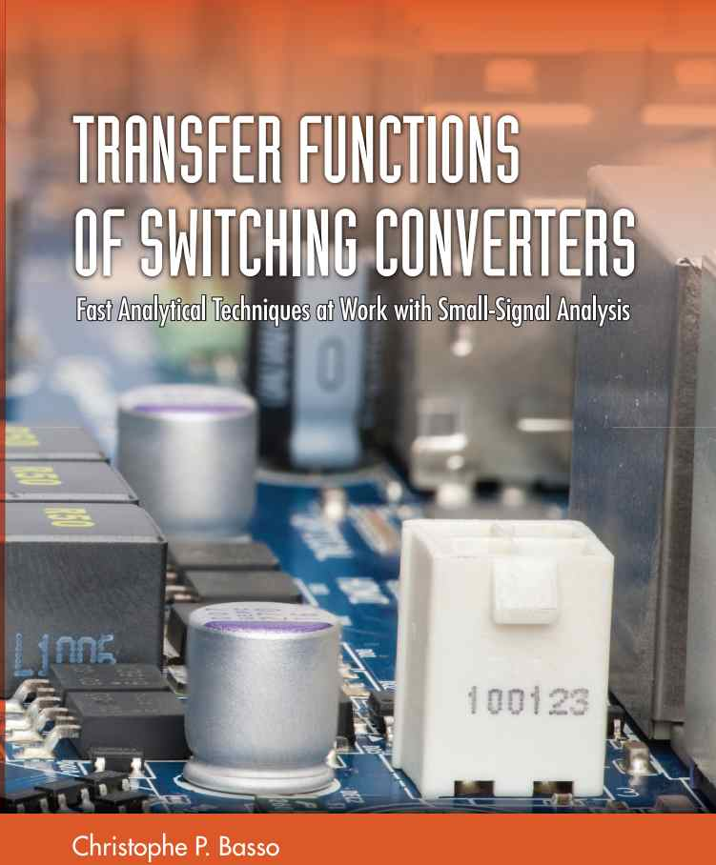
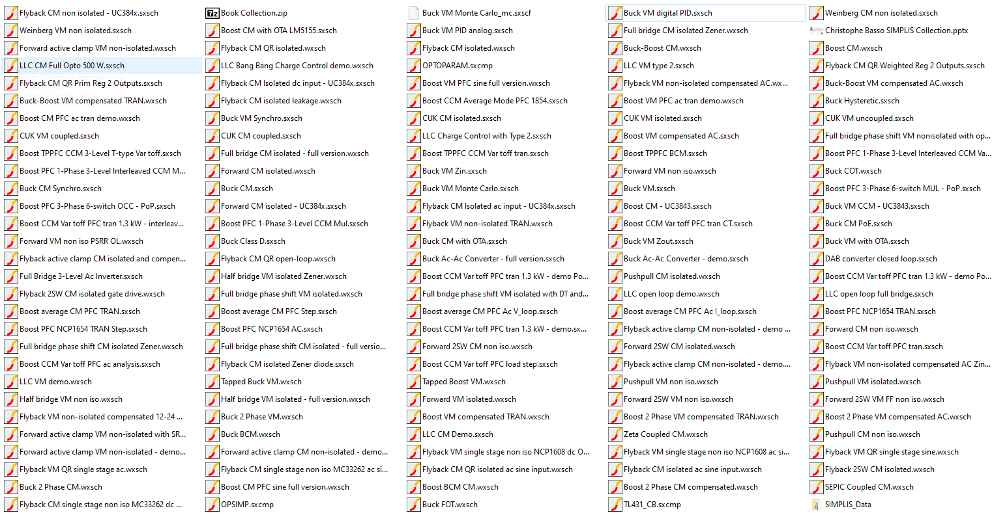
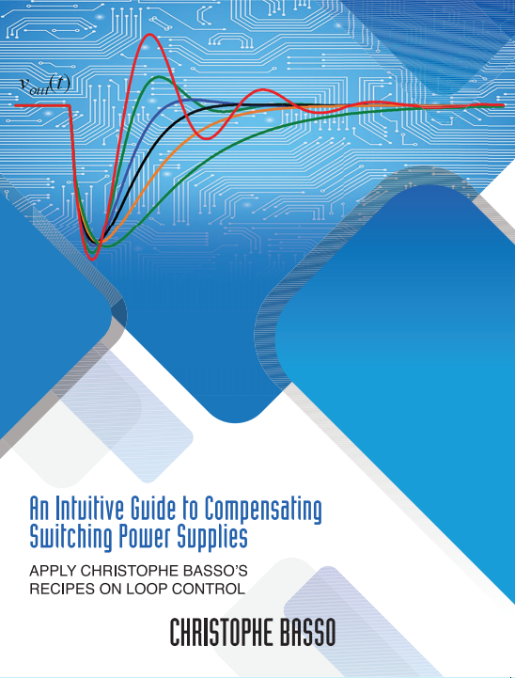
Released in June 2021
There are 130+ free to download simulation templates
≈80% of these circuits work with the demonstration version Elements
Released in September 2024
Christophe Basso – SIMPLIS Round Table – September 2024

Slide 5
SIMPLIS Essentials Training
Daily Schedule:
11:00 am EDT Welcome
11:05 am Begin class
~1:00 pm 20 min Lunch Break
~1:30 pm Begin second session
~ 2:45 pm Christophe Basso (Sampling of > 130 SIMPLIS Templates for Switching Power Supplies. Modeling and Measurement techniques)
3:30 pm Done for the day
We will start on time
We will finish on time

Slide 6

Welcome
SIMPLIS Essentials Training course
    We have a lot of material to cover
This is an interactive class – Ask questions
    Via the Questions panel
Be patient
    We will get to your questions

Slide 7
We Believe
SIMPLIS is the best simulation tool for
switching power supply design and analysis
…because SIMPLIS is the best power supply simulation tool for
    AC analysis
      Bode Plots
      Input & Output impedance
    Loss Analysis
      MOSFET & Driver losses
      Magnetics losses (SIMetrix/SIMPLIS 8.4+)
        Magnetics Design Module
    Transient analysis
      Step Load & Line
      Robust feature design (such as)
        Current limit
        Dead Time optimization
    Digital Control

Slide 8
The SIMPLIS Eco System
System Manufacturers
Power Supply Design
IC Manufacturers
Power
Device Manufacturers
Power Supply
Manufacturers

Slide 9
The SIMPLIS Eco System
System Manufacturers
New Product
Definition
System Architect
IC Designer
Device Manufacturers
Power Supply
Manufacturers
IC Manufacturers

Slide 10
We Believe
SIMPLIS is the best simulation tool for
switching power supply design and analysis
  Power Supply design
  New Product Definition for Power Management ICs
  Interacting with Suppliers during System Design process
  Interacting with customers during Design Win process
Because we believe this information is so valuable, the course has been designed so that you can get the most value in the shortest time.

Slide 11
Our Goal
Launch you on path to becoming
  Competent
  Confident
  that you can use SIMPLIS to improve your design process.
To accomplish this goal, we need to stay focused
  We have a lot of material to cover in 2 half-day sessions

Slide 12
Our Agenda
Course designed to provide understanding of
  How SIMPLIS works, and
  How to make SIMPLIS work in your application
We focus on
  Key concepts that differentiate SIMPLIS from Spice
  Critical modeling techniques for creating fast & accurate models of your products
  Tools that allow you to perform these tasks in less time with more complete corner-case coverage

Slide 13
This 2 x Half-Day Course is Not About
Everything you need to know about SIMPLIS
  This Introduction is no substitute for our
  3-day Advanced SIMPLIS Training course
Why SIMPLIS isn’t like your favorite flavor of Spice
The SIMPLIS “secret sauce” IP

Slide 14
Our Agenda
Lots of hands-on Exercises
Questions & Discussion are key to learning
  To provide you with the most value, we may prioritize your questions
    On current topic – immediate response
    On upcoming topic – deferred response
    Side topic – after the class

Slide 15
SIMPLIS Essentials Training
Daily Schedule:
11:00 am EDT Welcome
11:05 am Begin class
~1:00 pm 20 min Lunch Break
~1:30 pm Begin second session
~ 2:45 pm Christophe Basso (Sampling of > 130 SIMPLIS Templates for Switching Power Supplies. Modeling and Measurement techniques)
3:30 pm Done for the day
We will start on time
We will finish on time

Slide 16
Agenda
First half-day Session
Second Half-Day Session
Module 1 - SIMPLIS Basics
1.0.1 SIMPLIS is a Time-Domain Simulator, all the Time, for Every Analysis, Period
1.0.2 PWL Simulation and Modeling
1.0.3 Multi-Level Modeling
1.0.4 Accuracy of PWL Models
1.0.5 POP and AC Analysis
Christophe Basso:
  SIMPLIS Templates for Switching Power Supplies. - Modeling and Measurement techniques
Module 2 - Advanced SIMPLIS
2.0 Transient Analysis Settings
2.1 Initial Conditions
  2.1.1 The Initial Conditions (.INIT) File
2.2 How POP Really Works
  2.2.1 Overview of the Periodic Operating Point (POP) Analysis
  2.2.2 The Core POP Process
  2.2.3 POP Error Messages
  2.2.4 Circuits Which Cause POP to Fail
Chris Swartz:
  Modelling & Measuring EMI for Switching Power Supplies.
Wrap up

Slide 18
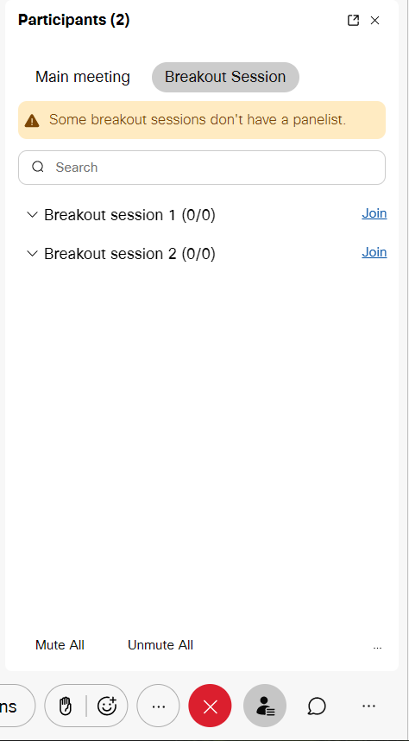
WebEx Breakouts:
WebEx Breakouts will be used during some of our breaks.
We will divide you into smaller groups.
We request webcams to be turned on for this time.
To enter a Breakout Session, select:
    Participants
    Breakout Session
    Join

Slide 19
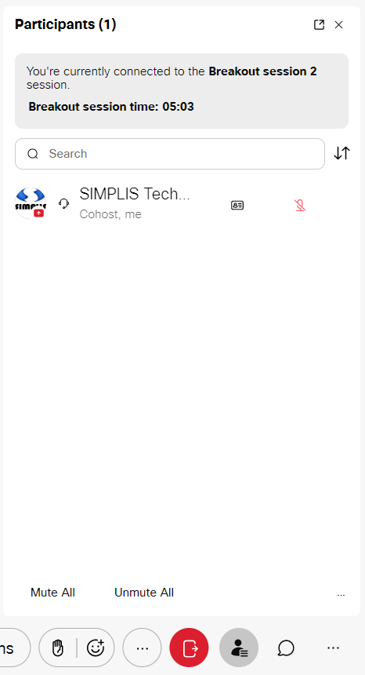

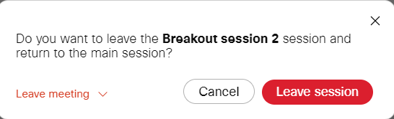

WebEx Meetings Breakouts:
To leave a Breakout Session, select Participants
and
You will receive the following message
Select and you will be sent to the
    Main Session.

Slide 20
Breakout Session Topics
Modeling MOSFETs and MOSFET Losses
Design Verification Module

Slide 22
Introduction to SIMPLIS -- check list: ref: email from Matt Fortin
Subject: SIMPLIS Training -- Remote Desktop Login Information -- READ CAREFULLY
GoToTraining material
  Display on external monitor
  Mute your microphone
  Locate GoToTraining chat window
Remote Desktop session (do not minimize this window)
  Display on Laptop monitor
  Open SIMetrix/SIMPLIS
  Open Advanced SIMPLIS Training docs
  Open Rocket.Chat window

Slide 23
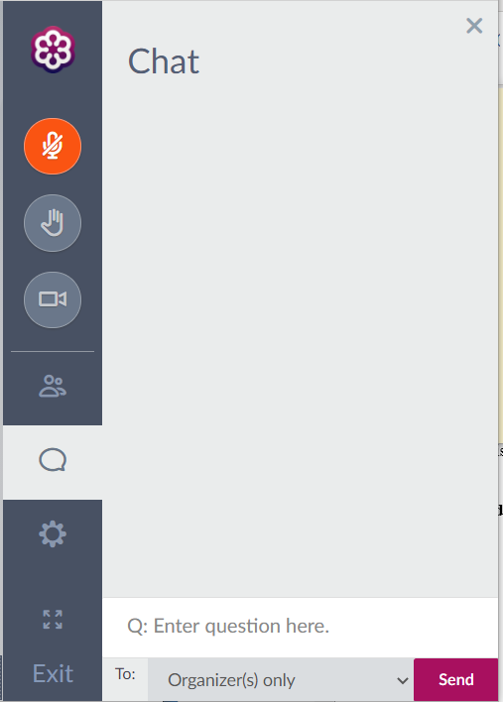
For questions to the Trainer:
Type your question in Chat
(GoToTraining session)
  Start your question with Q:
  “Q: Enter question here.”

Slide 24

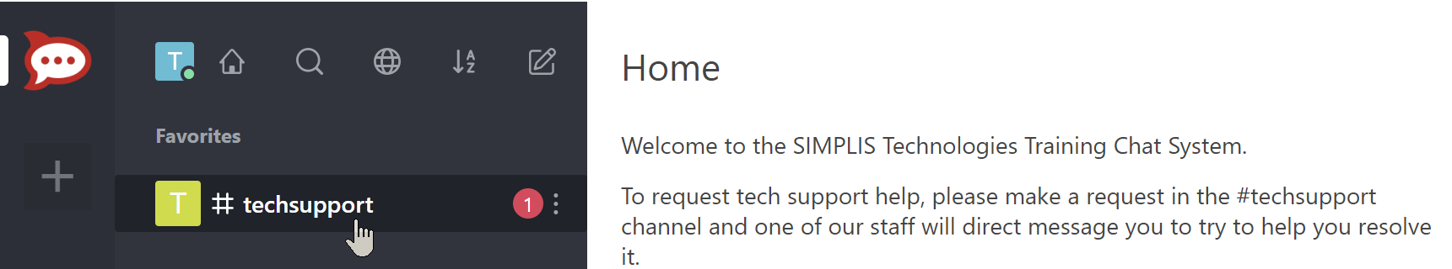
For Technical Support during training: ref: email from Matt Fortin
Subject: SIMPLIS Training -- Remote Desktop Login Information -- READ CAREFULLY
1. Open tech support chat window (in your Remote Desktop session)
2. Rocket.Chat login information:
• Username: Email username
• Password: SIMPLISTraining0521
3. Click on # techsupport
  … and let us know what your issue is via the # techsupport chat window.

Slide 25
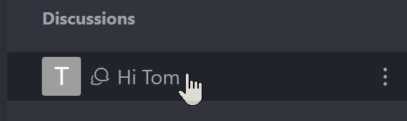
For Technical Support during training:
4. You will receive a response from our engineers in an individual Discussion channel
5. If things get desperate, we may need to actually view your Remote Desktop session & possibly take control of your keyboard and mouse to fix your problem.

Slide 27
Today’s Agenda
8:00 - 8:20 EST Setup & Logistics
8:20 – 8:30 Welcome
8:30 - 10:00 1.0 SIMPLIS Basics Matt Fortin
10:00 - 10:15 Break
10:15 – 12:00 2.1.1 The Initial Conditions (.INIT) File
            2.2 How POP Really Works
1.0.1 SIMPLIS is a Time-Domain Simulator
1.0.2 PWL Simulation and Modeling
1.0.3 Multi-Level Modeling
1.0.4 Accuracy of PWL Models
1.0.5 POP and AC Analysis

Slide 28
Our Agenda
Lots of hands-on Exercises
Questions & Discussion are key to learning
  To provide you with the most value, we may bin your questions
    On current topic – immediate response
    On upcoming topic – deferred response
    Side topic – discuss at break

Slide 29
One-Day SIMPLIS Training
Hangzhou Easitech
October 18, 2019
8:00 am – 5:00 pm
SIMPLIS Technologies
Tom Wilson
John Wilson

Slide 30
Delta SIMPLIS Training
Delta Tainan
October 24, 2019
SIMPLIS Technologies
Tom Wilson
John Wilson
Please make sure:
You have access to the Internet
You can run a SIMPLIS simulation

Slide 31
Delta SIMPLIS Training
Delta Tauyuan
October 25, 2019
SIMPLIS Technologies
Tom Wilson
John Wilson
Please make sure:
You can run a SIMPLIS simulation

Slide 32
The Course is Not About
Why SIMPLIS isn’t like your favorite flavor of Spice
The SIMPLIS “secret sauce” IP

Slide 33
Agenda Topics
Monte Carlo Analysis in SIMPLIS
C-code dll for describing SIMPLIS digital functions
(SIMPLIS Pro and Elite versions 8.4+)
Break
Periodic Operating Point Analysis – How it works
Magnetics Design Module
(works with all SIMPLIS version 8.4+)
    simplis.com/docs
    simplis.com/documentation/link/simplis/4000

Slide 34
Advanced SIMPLIS Training
8:30 am – 5:00 pm CDT
October 20 - 22, 2021
SIMPLIS Technologies
Andrija Stupar
Ron Wong
Tom Wilson
Matt Fortin
John Wilson
Aimee Kriz
Chris Lovell
Instructors
Organizer

Slide 35
One-Day SIMPLIS Training
IntergraTech
October 29, 2019
9:00 am – 5:30 pm
SIMPLIS Technologies
Tom Wilson
John Wilson
Please make sure:
You have access to the Internet
You can run a SIMPLIS simulation

Slide 36
Introduction to SIMPLIS
8:00 am – 12:00 pm EST
14:00 – 18:00 CET
Dec 8, 2020
SIMPLIS Technologies
Matt Fortin
Tom Wilson
Aimee Kriz
Ron Wong
Andrija Stupar
John Wilson
Chris Lovell
Instructors
Organizer
Tech Support

Slide 37
Advanced SIMPLIS Training
9:00 am – 17:30 pm CEDT
May 19 - 21, 2021
SIMPLIS Technologies
Andrija Stupar
Ron Wong
Tom Wilson
Matt Fortin
John Wilson
Chris Lovell
Instructors
Organizer

Slide 38
Daily Schedule
8:30 - 8:50 CDT Setup & Logistics
8:50 – 9:00 Welcome
09:00 Begin class
~10:45 Morning Break
~12:45 Lunch Break
~13:15 Begin afternoon session
~15:30 Afternoon Break
17:30 Done for the day
We will start on time
We will end on time
First Morning

Slide 40
Best Practices for New Product Definition for Power Management ICs
AC Analysis for PFC

Slide 41
The SIMPLIS Eco System
System Manufacturers
Customer-Supplier
Relationships
Power Management IC Manufacturers
Power
Device Manufacturers
Power Supply
Manufacturers

Slide 42
The SIMPLIS Eco System
System Manufacturers
Collaborative
Electrical
&
Magnetic
Design
Power Management IC Manufacturers
Power
Magnetic
Device Designers
Power Supply
Manufacturers

Slide 43
The SIMPLIS Eco System
System Manufacturers
Power Management IC Manufacturers
Power
Device Manufacturers
Power Supply
Manufacturers

